Slide 1
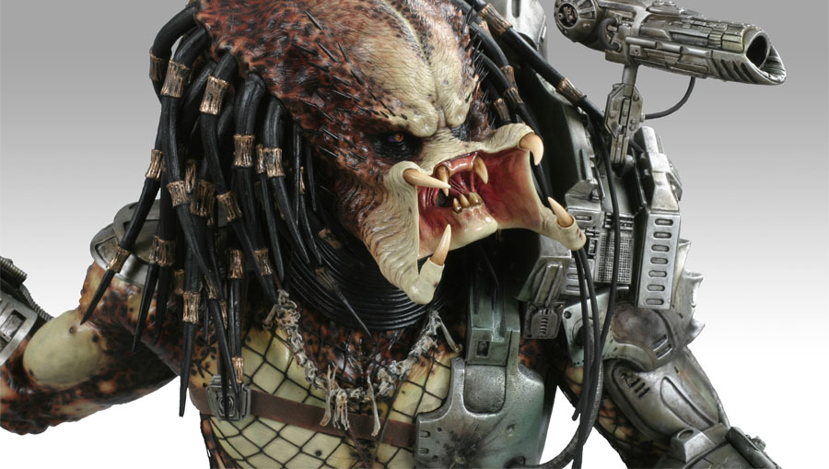
Predator Cannon
Ethan Jacobs
Nick Middlebrooks
Andrew Wood

Slide 2
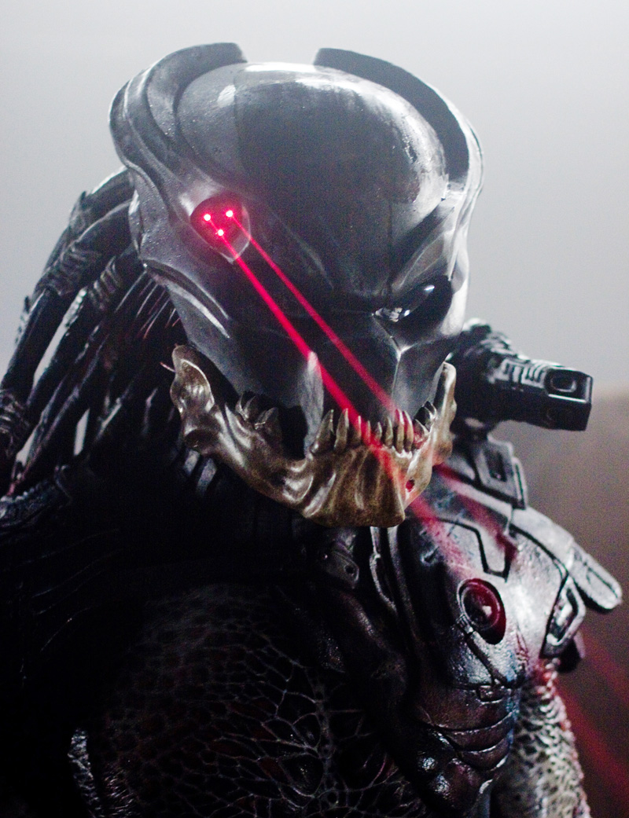
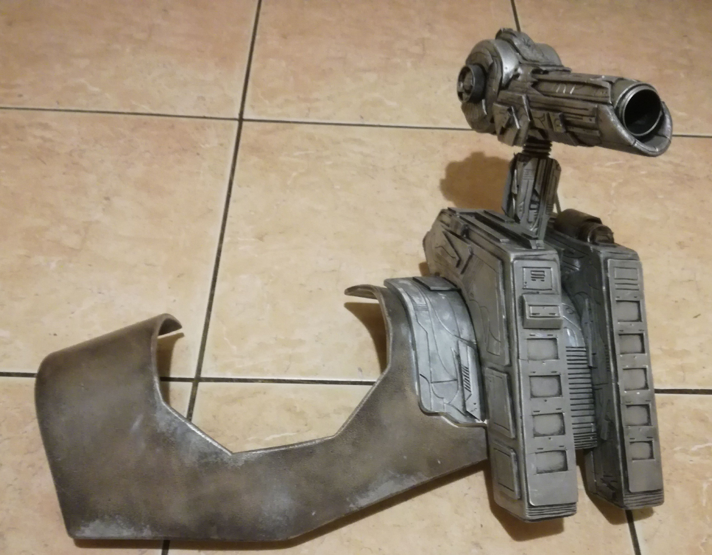
Predator Cannon: Overview
Proposal - Mount a nerf blaster on a person’s shoulder that can follow head movements and track a laser sight to prepare to shoot on command.

Slide 3
Predator Cannon: Requirements
The system shall have red emergency stop buttons mounted on the operator’s harness that shall cut power to the blaster system.
One button shall be located on the back (operator’s upper back) of the harness.
One button shall be located on the front (operator’s sternum) of the harness.
The system shall not impede the operator from pressing the front emergency stop button.
The system shall have a safe mode that prevents the blaster from firing.
The system shall have a labeled colored light indicator to show that it is in a safe mode.
The light indicator shall be visible from any angle around operator
The system shall boot into safe mode
The system shall not exceed OSHA weight limit.
Materials Handling: Heavy Lifting - 50 lb limit
The system shall be able to be equipped in less than 30 seconds.
The system shall be able to be unequipped in less than 5 seconds.
The system shall come with eye protection for the human operator that meets or exceeds OSHA standard 1910.133 - Eye and Face Protection.
At least one Nerf blaster shall be mounted on shoulder region.
The Nerf blaster shall be padded such that it is impossible for the operator to touch their head to any part of the blaster that is not padded.
At least one laser emitter shall be mounted on the head region.
Human operator shall initiate Nerf blaster firing through physical command input.
The system shall contain all processing onboard the harness.
The system shall have an on-board power delivery system.
In a dimly lit room, a nerf dart fired from a nerf blaster at a wall inside a 10 ft. range shall hit the wall within 1 ft. radius of the laser point projection (or center of 3 points) at least once out of three tries.

Slide 4
Predator Cannon: Concept Outline
Control
Hand device with inputs for firing, setup/realignment, and estop
Raspberry Pi or Laptop strapped to head
Shoulder Mounted Blaster
Single shot Nerf blaster
2 servo motors for yaw and pitch aiming
IMU senses blaster orientation
Camera senses laser points
Computer output for firing/depressing trigger
Head Mounted Laser Designator
Laser pointer (possibly 3 laser pointers in a tight equilateral triangle)
IMU senses head orientation

Slide 5
Predator Cannon: Mechanical Outline
Shoulder Mount
Harness
Servo mount point chassis
Nerf mount bracket to Servo
Head Mount
Safety Glasses
IMU
Laser
Human Control Device
Wii Nunchuk or similar device
Input device for firing
Input device for alignment/zeroing
Estop buttons

Slide 6
Predator Cannon: Software Outline
Two targeting routines
Orientation Matching
Blaster will mirror head orientation
Sensors: IMUs on head and blaster
Pro - Robust
Con - Imprecise & sensor drift
Image Processing
Blaster will target laser point
Sensors: Camera on blaster (Wii IR camera or ps3 camera)
Pro - Precise
Con - Loses laser if out of frame or move too quickly (Not robust)

Slide 7
Predator Cannon: Electrical Outline
Things that need power:
Computing device
Camera peripheral
Mbed
IMU for head tracking
IMU for blaster tracking
Input buttons
Laser pointer
Servos
Battery pack
20000 mAh battery pack

Slide 8
Predator Cannon: Prototype
List of things that the prototype will do:
Implement Targeting Routine 1 - Orientation matching
Have 2 servos that can do pitch and yaw
IMU feedback for positioning
Mbed processing for IMU
Servos will point in the direction the IMU is pointing
Human control device for mock firing and safety stop

Slide 9
Predator Cannon: Initial Schedule
Objective | Completed By
Preliminary Design | 1/18
Proof of concept Prototype | 2/1
Proof of concept Presentation | 2/6
Detailed Design | 2/15
Midterm Status Report | 2/20
Build Project | 3/8
Testing and Troubleshooting | 3/22
Re-evaluate Requirements | 4/3
Re-build project if necessary | 4/15
Final Presentation | 4/22

Slide 10
Predator Cannon: Estimated Budget
Item | Cost | In House? | Revised Price
Servos (2) | $16 | Yes | $0
Lasers (3) | $5 | No | $5
Chassis/harness | $40 | Yes | $0
Mbed | $51 | Yes | $0
Interface/button | $30 | Yes | $0
Glasses/headband | $12 | No | $12
IMU | $15 | No | $15
IR camera | $36 | No | $36
Nerf gun | $25 | No | $25
total | $230 |  | $93

Slide 11
